Slide 1
Theory of Computation
Lecture 5
NFA to DFA
2 methods

Slide 2
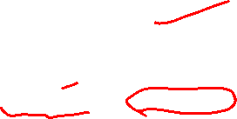
Syllabus and Terminologies
Regular Languages .. Regular Sets
REs (Regular Expressions)
FSMs (or FSA/FA) … Finite State Machines/Automata
DFA vs. NFA … Deterministic vs. Non-deterministic FSA
Comparison and conversion
Examples & Closure Operations
Pumping Lemma
Context Free Languages
CFGs … Context Free Grammars
PDA … Push Down Automata
Parsing: CFG generating strings vs. PDA recognizing strings
Turing Machine

Slide 3
How to convert NFA to DFA??
High-level sketch
NFA
Regular
expressions
DFA
Lexical
Specification
Table-driven
Implementation of DFA

Slide 4
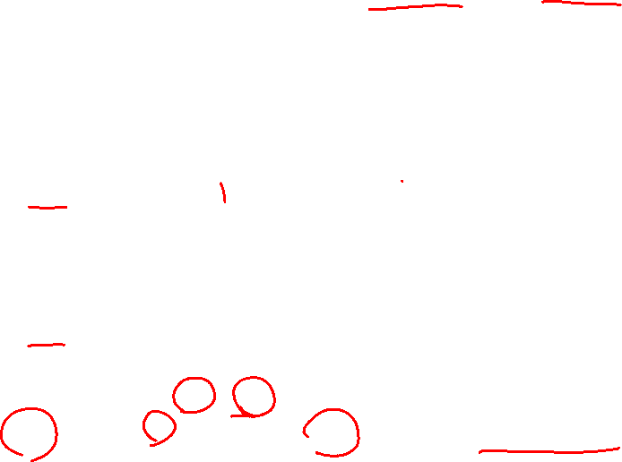
How to convert from NFA to DFA
Create a Graph G_{D} with vertex {q₀}
Repeat until no more edges are missing
Take any vertex {q_{i}, q_{j}, .. q_{k}} of G_{D} that has no outgoing edge
Compute δ*(q_{i}, a), δ*(q_{j}, a).. δ*(q_{k}, a)
Form a union of all these δ* {q_{l}, q_{m}, .. q_{n}}
Create a vertex for G_{D} labeled {q_{l}, q_{m}, .. q_{n}}, if does not exist
Add an edge a from {q_{i}, q_{j}, .. q_{k}} to {q_{l}, q_{m}, .. q_{n}}
Any vertex has q_{f} ∈ F_{N} is identified as a final state
If M_{N} accepts λ, the vertex {q₀} in G_{D} is a final state

Slide 5
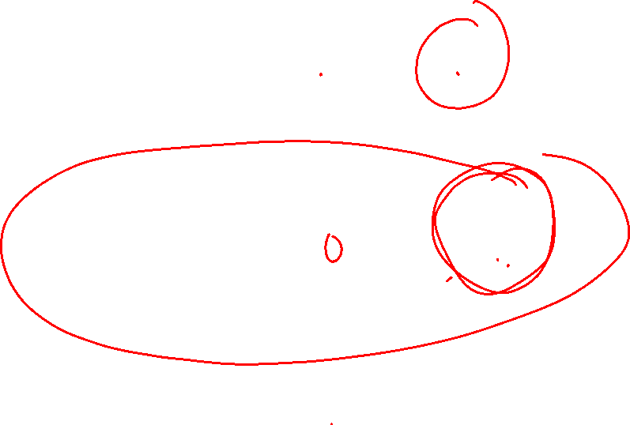
NFA to DFA conversion intuition
0, 1
NFA:
q₀
1
q₁
0
q₂
0
0
DFA:
q₀
1
q₀ or q₁
0
q₀ or q₂
1
1

Slide 6
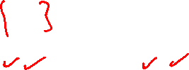
NFA to DFA conversion intuition
0, 1
NFA:
q₀
1
q₁
0
q₂
0
0
DFA:
q₀
1
{q₀, q₁}
0
{q₀, q₂}
1
1

Slide 7
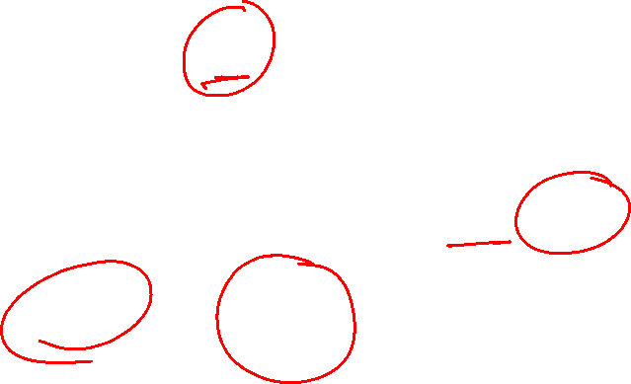
NFA to DFA
We are given an NFA
We want to convert it to an equivalent DFA

Slide 8
NFA to DFA
If the NFA has states
the DFA has states in the power set

Slide 9
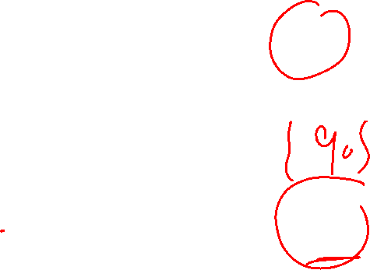
Procedure NFA to DFA
1. Initial state of NFA:
Initial state of DFA:

Slide 10

Example
NFA
DFA

Slide 11
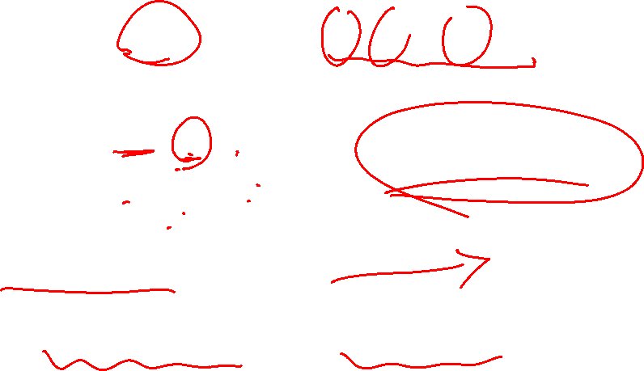
Procedure NFA to DFA
2. For every DFA’s state
Compute in the NFA
Add transition

Slide 12

Example
NFA
DFA

Slide 13

Procedure NFA to DFA
Repeat Step 2 for all letters in alphabet, until no more transitions can be added.

Slide 14
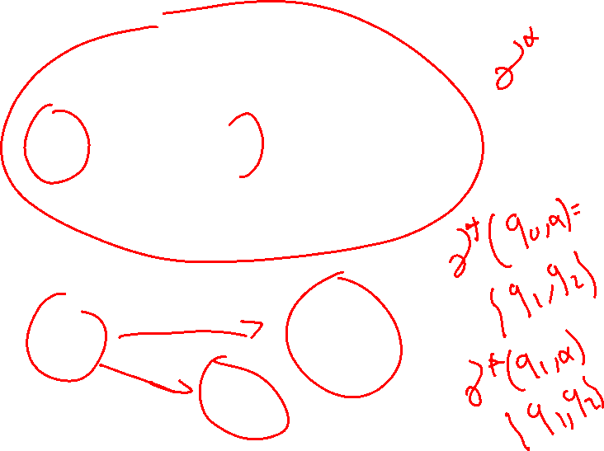
NFA to DFA
NFA
DFA

Slide 15
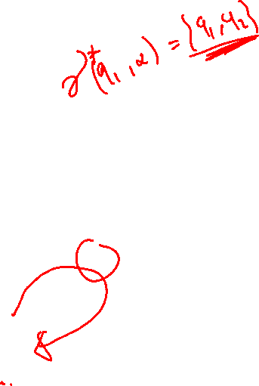
NFA to DFA
NFA
DFA

Slide 16
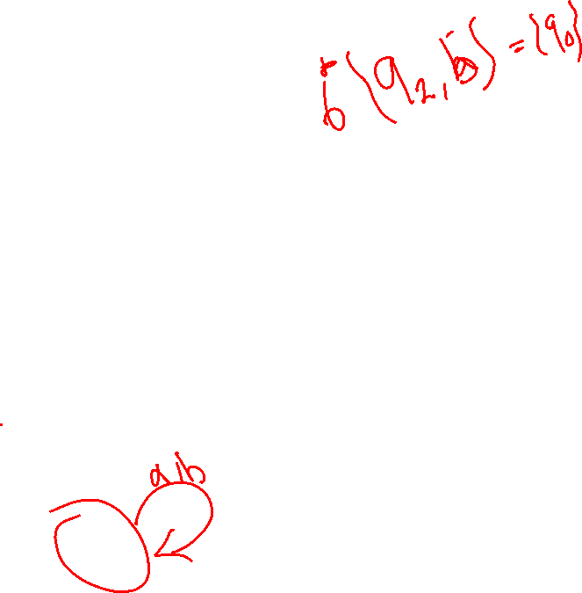
NFA to DFA
NFA
DFA

Slide 17
NFA to DFA
NFA
DFA

Slide 18
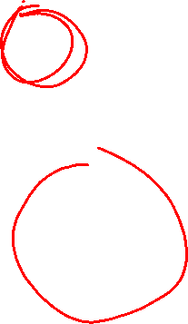
NFA to DFA … where is the final state?
NFA
DFA

Slide 19
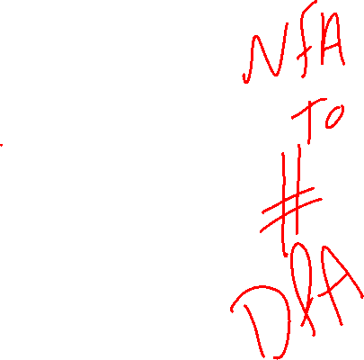
NFA to DFA
NFA
DFA

Slide 20
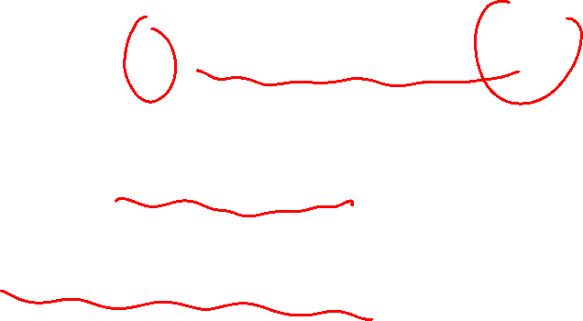
Procedure NFA to DFA
3. For any DFA state
If some is a final state in the NFA
Then,
is a final state in the DFA

Slide 21
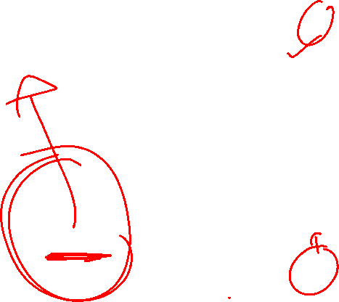
Example
NFA
DFA

Slide 22

Theorem
Take NFA
Apply procedure to obtain DFA
Then and are equivalent :

Slide 23
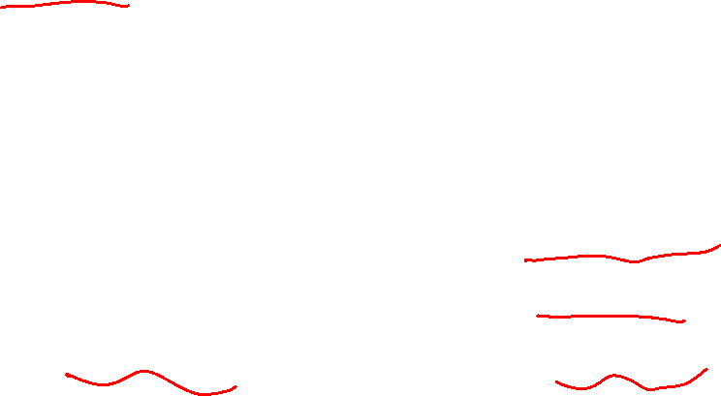
Finally
We have
Languages
accepted
by NFAs
Languages
accepted
by DFAs

Slide 24
NFA to DFA Formal Graphical Method

Slide 25

NFA to DFA
To transfer from NFA to DFA we need some method for eliminating both:
or ε transitions, and
Multiple transitions from a state on a single input character.
Eliminating ε transitions involves the construction of ε-closures .
ε–closure of a single state s ( s ): is the set of states reachable by a series of zero or more ε transitions.

Slide 26
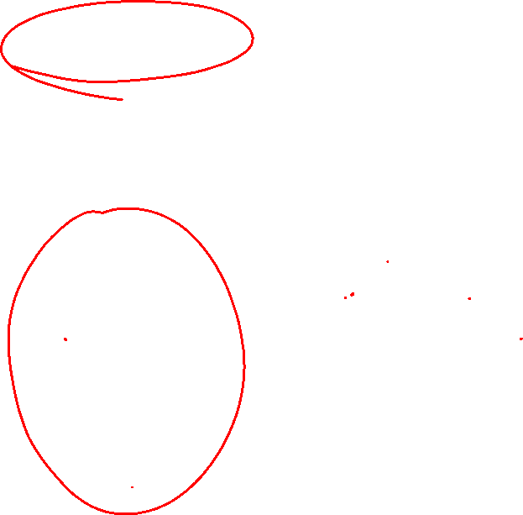
ε–closure
ε
In this NFA:
1 = {1,2,4}
2 = {2}
3 = {2,3,4}
4 = {4}
ε
a
ε
1
2
3
4
ε

Slide 27

NFA to DFA Method
Input: An NFA S = States = { s₀, s₁, ..., s_{N}} = S_{NFA}
δ = Transition function = Transition_{NFA}
δ: (Q x Σ) –> 2^{Q} -2^{Q} is the power set of Q, the set of all subsets of Q
δ(q,s) is a function from Q x S to 2^{Q} (but not to Q)
Output: A DFA S = States = {?, ?, ..., ?} = S_{DFA}
f = Transition function = Transition_{DFA}
f: Q x Σ→Q
Main Idea: Each state in S_{DFA}will be a set of states from the NFA
S_{DFA} = { {...}, {...} , ..., {...}}
NFA DFA
q₁, q₂

Slide 28
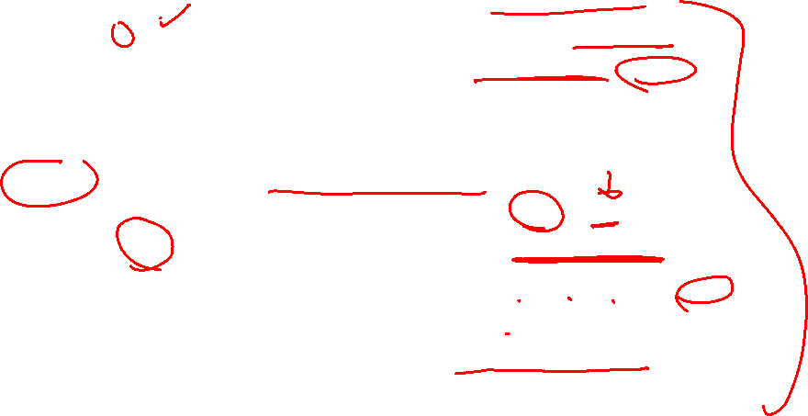
NFA to DFA method
We’ll use...
Transition_{NFA}(S,a) the transition function from NFA
ε-Closure(I) where I is a single state from NFA
ε-Closure(S) where S is a set of states from NFA
We’ll construct...
S_{DFA} the set of states in the DFA
Initially, we’ll set S_{DFA} to {}
Add X to S_{DFA} where X is some set of NFA states
Example: “Add {q0, q1, q2} to S_{DFA}”
We’ll “mark” some of the states in the DFA.
Marked = “We’ve done this one”
Unmarked= “Still need to do this one”

Slide 29
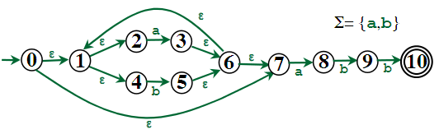
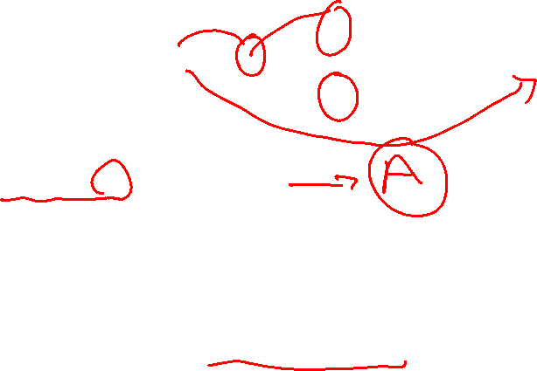
example
Start state:
ε-Closure (0) = {0, 1, 2, 4, 7}
Call it A
A is the first node in the equivalent DFA
A

Slide 30

Example CONT.
Start state:
ε-Closure (0) = {0, 1, 2, 4, 7} = A
Start state:
ε-Closure (0) = {0, 1, 2, 4, 7}
Call it A
a
?
A
b
?

Slide 31
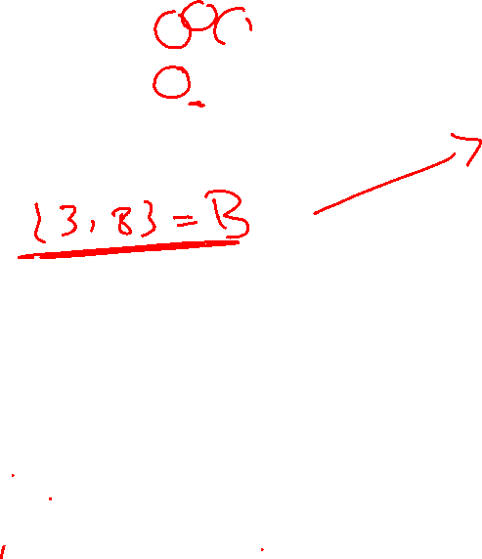
Example CONT.
Start state:
ε-Closure (0) = {0, 1, 2, 4, 7} = A
Transition_{DFA}(A,a)
=
Transition_{DFA}(A,b)
=
a
?
A
b
?

Slide 32
Example CONT.
Start state:
ε-Closure (0) = {0, 1, 2, 4, 7} = A
Transition_{DFA}(A,a)
= ε-Closure (Transition_{NFA}(A,a))
=
Transition_{DFA}(A,b)
=
a
?
A
b
?

Slide 33
Example CONT.
Start state:
ε-Closure (0) = {0, 1, 2, 4, 7} = A
Transition_{DFA}(A,a)
= ε-Closure (Transition_{NFA}(A,a))
= ε-Closure ({3,8})
=
Transition_{DFA}(A,b)
=
a
?
A
b
?

Slide 34
Example CONT.
Start state:
ε-Closure (0) = {0, 1, 2, 4, 7} = A
Transition_{DFA}(A,a)
= ε-Closure (Transition_{NFA}(A,a))
= ε-Closure ({3,8})
= {1,2,3,4,6,7,8} = B
Transition_{DFA}(A,b)
=
a
B
A
b
?

Slide 35
Example CONT.
Start state:
ε-Closure (0) = {0, 1, 2, 4, 7} = A
Transition_{DFA}(A,a)
= ε-Closure (Transition_{NFA}(A,a))
= ε-Closure ({3,8})
= {1,2,3,4,6,7,8} = B
Transition_{DFA}(A,b)
= ε-Closure (Transition_{NFA}(A,b))
=
a
B
A
b
?

Slide 36
Example CONT.
Start state:
ε-Closure (0) = {0, 1, 2, 4, 7} = A
Transition_{DFA}(A,a)
= ε-Closure (Transition_{NFA}(A,a))
= ε-Closure ({3,8})
= {1,2,3,4,6,7,8} = B
Transition_{DFA}(A,b)
= ε-Closure (Transition_{NFA}(A,b))
= ε-Closure ({5})
=
a
B
A
b
?

Slide 37
Example CONT.
Start state:
ε-Closure (0) = {0, 1, 2, 4, 7} = A
Transition_{DFA}(A,a)
= ε-Closure (Transition_{NFA}(A,a))
= ε-Closure ({3,8})
= {1,2,3,4,6,7,8} = B
Transition_{DFA}(A,b)
= ε-Closure (Transition_{NFA}(A,b))
= ε-Closure ({5})
= {1,2,4,5,6,7} = C
a
B
A
b
C

Slide 38
Example CONT.
Start state:
ε-Closure (0) = {0, 1, 2, 4, 7} = A
Transition_{DFA}(A,a)
= ε-Closure (Transition_{NFA}(A,a))
= ε-Closure ({3,8})
= {1,2,3,4,6,7,8} = B
Transition_{DFA}(A,b)
= ε-Closure (Transition_{NFA}(A,b))
= ε-Closure ({5})
= {1,2,4,5,6,7} = C
a
B
A
b
C

Slide 39

Example CONT.
Start state:
ε-Closure (0) = {0, 1, 2, 4, 7} = A
Transition_{DFA}(A,a)
= ε-Closure (Transition_{NFA}(A,a))
= ε-Closure ({3,8})
= {1,2,3,4,6,7,8} = B
Transition_{DFA}(A,b)
= ε-Closure (Transition_{NFA}(A,b))
= ε-Closure ({5})
= {1,2,4,5,6,7} = C
So far:
a
B
A
b
C
A is now done; mark it!
B and C are unmarked.
Let’s do B next...

Slide 40
Example CONT.
Process B = {1,2,3,4,6,7,8}
a
B
A
b
C

Slide 41
Example CONT.
Process B = {1,2,3,4,6,7,8}
Transition_{DFA}(B,a)
=
a
B
A
b
C

Slide 42
Example CONT.
Process B = {1,2,3,4,6,7,8}
Transition_{DFA}(B,a)
= ε-Closure (Transition_{NFA}(B,a))
=
a
B
A
b
C

Slide 43
Example CONT.
Process B = {1,2,3,4,6,7,8}
Transition_{DFA}(B,a)
= ε-Closure (Transition_{NFA}(B,a))
= ε-Closure ({3,8})
=
a
B
A
b
C

Slide 44
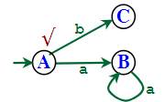
Example CONT.
Process B = {1,2,3,4,6,7,8}
Transition_{DFA}(B,a)
= ε-Closure (Transition_{NFA}(B,a))
= ε-Closure ({3,8})
= {1,2,3,4,6,7,8} = B
Transition_{DFA}(B,b)
=

Slide 45
Example CONT.
Process B = {1,2,3,4,6,7,8}
Transition_{DFA}(B,a)
= ε-Closure (Transition_{NFA}(B,a))
= ε-Closure ({3,8})
= {1,2,3,4,6,7,8} = B
Transition_{DFA}(B,b)
= ε-Closure (Transition_{NFA}(B,b))
=

Slide 46
Example CONT.
Process B = {1,2,3,4,6,7,8}
Transition_{DFA}(B,a)
= ε-Closure (Transition_{NFA}(B,a))
= ε-Closure ({3,8})
= {1,2,3,4,6,7,8} = B
Transition_{DFA}(B,b)
= ε-Closure (Transition_{NFA}(B,b))
= ε-Closure ({5,9})
=

Slide 47
Example CONT.
Process B = {1,2,3,4,6,7,8}
Transition_{DFA}(B,a)
= ε-Closure (Transition_{NFA}(B,a))
= ε-Closure ({3,8})
= {1,2,3,4,6,7,8} = B
Transition_{DFA}(B,b)
= ε-Closure (Transition_{NFA}(B,b))
= ε-Closure ({5,9})
= {1,2,4,5,6,7,9} = D

Slide 48
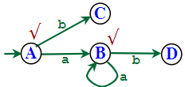
Example CONT.
Process B = {1,2,3,4,6,7,8}
Transition_{DFA}(B,a)
= ε-Closure (Transition_{NFA}(B,a))
= ε-Closure ({3,8})
= {1,2,3,4,6,7,8} = B
Transition_{DFA}(B,b)
= ε-Closure (Transition_{NFA}(B,b))
= ε-Closure ({5,9})
= {1,2,4,5,6,7,9} = D

Slide 49
Example CONT.
Process C = {1,2,4,5,6,7}

Slide 50
Example CONT.
Process C = {1,2,4,5,6,7}
Transition_{DFA}(C,a) =
Transition_{DFA}(C,b) =

Slide 51
Example CONT.
Process C = {1,2,4,5,6,7}
Transition_{DFA}(C,a) = {1,2,3,4,6,7,8} = B
Transition_{DFA}(C,b) =

Slide 52
Example CONT.
Process C = {1,2,4,5,6,7}
Transition_{DFA}(C,a) = {1,2,3,4,6,7,8} = B
Transition_{DFA}(C,b) = {1,2,4,5,6,7} = C

Slide 53
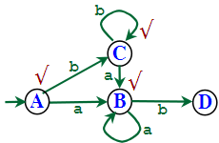
Example CONT.
Process C = {1,2,4,5,6,7}
Transition_{DFA}(C,a) = {1,2,3,4,6,7,8} = B
Transition_{DFA}(C,b) = {1,2,4,5,6,7} = C

Slide 54
Example CONT.
Process C = {1,2,4,5,6,7}
Transition_{DFA}(C,a) = {1,2,3,4,6,7,8} = B
Transition_{DFA}(C,b) = {1,2,4,5,6,7} = C
Process D = {1,2,4,5,6,7,9}
Transition_{DFA}(D,a) =
Transition_{DFA}(D,b) =

Slide 55
Example CONT.
Process C = {1,2,4,5,6,7}
Transition_{DFA}(C,a) = {1,2,3,4,6,7,8} = B
Transition_{DFA}(C,b) = {1,2,4,5,6,7} = C
Process D = {1,2,4,5,6,7,9}
Transition_{DFA}(D,a) = {1,2,3,4,6,7,8} = B
Transition_{DFA}(D,b) =

Slide 56
Example CONT.
Process C = {1,2,4,5,6,7}
Transition_{DFA}(C,a) = {1,2,3,4,6,7,8} = B
Transition_{DFA}(C,b) = {1,2,4,5,6,7} = C
Process D = {1,2,4,5,6,7,9}
Transition_{DFA}(D,a) = {1,2,3,4,6,7,8} = B
Transition_{DFA}(D,b) = {1,2,4,5,6,7,10} = E

Slide 57
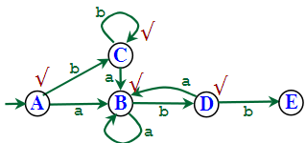
Example CONT.
Process C = {1,2,4,5,6,7}
Transition_{DFA}(C,a) = {1,2,3,4,6,7,8} = B
Transition_{DFA}(C,b) = {1,2,4,5,6,7} = C
Process D = {1,2,4,5,6,7,9}
Transition_{DFA}(D,a) = {1,2,3,4,6,7,8} = B
Transition_{DFA}(D,b) = {1,2,4,5,6,7,10} = E

Slide 58
Example CONT.
Process E = {1,2,4,5,6,7,10}
Transition_{DFA}(E,a) =
Transition_{DFA}(E,b) =

Slide 59
Example CONT.
Process E = {1,2,4,5,6,7,10}
Transition_{DFA}(E,a) = {1,2,3,4,6,7,8} = B
Transition_{DFA}(E,b) =

Slide 60
Example CONT.
Process E = {1,2,4,5,6,7,10}
Transition_{DFA}(E,a) = {1,2,3,4,6,7,8} = B
Transition_{DFA}(E,b) = {1,2,4,5,6,7} = C

Slide 61
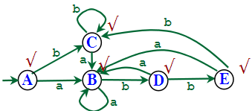
Example CONT.
Process E = {1,2,4,5,6,7,10}
Transition_{DFA}(E,a) = {1,2,3,4,6,7,8} = B
Transition_{DFA}(E,b) = {1,2,4,5,6,7} = C
Final States in DFA?
...which state(s) contain 10?

Slide 62
Final DFA

Slide 63
NFA vs. DFA !

